Slide 1

Exploratory Data Analysis (EDA) on Air Quality Index (AQI) Dataset
Presented by: Vishnu G Nath

Slide 2
01
INTRODUCTION
DATA OVERVIEW
02
AGENDA
DATA CLEANING
03
DATA ANALYSIS & VISUALIZATION
04
05
KEY RECOMMENDATION
PERFORMANCE INSIGHT
06

Slide 3

Introduction
Objective: To explore and analyze air quality data using AQI values from various countries and cities.
Dataset Overview: Includes AQI values and categories for different pollutants such as CO, Ozone, NO2, and PM2.5.
Tools Used: R programming language with ggplot2 and dplyr packages.

Slide 4
Data Overview
Dataset Size: 23,463 observations of 12 variables.
Key Variables:
Country
City
AQI Value
AQI Category
CO AQI Value
Ozone AQI Value
NO2 AQI Value
PM2.5 AQI Value

Slide 5

Data Cleaning
Handling Missing Values: Removed rows with missing data using dplyr ::filter() with complete.cases().
Renaming Columns: Standardized column names for consistency and ease of use.

Slide 6

Data Analysis & Visualizations

Slide 7
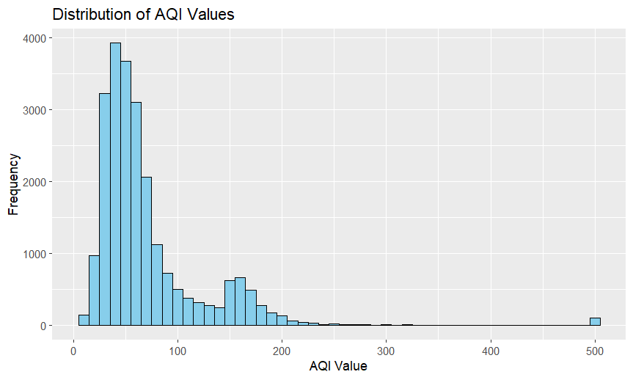
Univariate Analysis
ggplot(df, aes(x = AQI.Value)) + geom_histogram(binwidth = 10, fill = "skyblue", color = "black") + labs(title = "Distribution of AQI Values", x = "AQI Value", y = "Frequency")

Slide 8
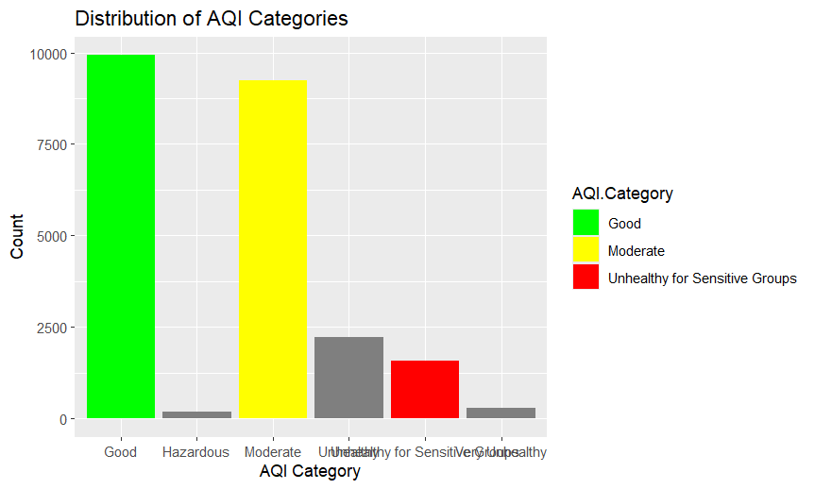
ggplot(df, aes(x = AQI.Category, fill = AQI.Category)) + geom_bar() + labs(title = "Distribution of AQI Categories", x = "AQI Category", y = "Count") + scale_fill_manual(values = c("Good" = "green", "Moderate" = "yellow", "Unhealthy for Sensitive Groups" = "red"))

Slide 9
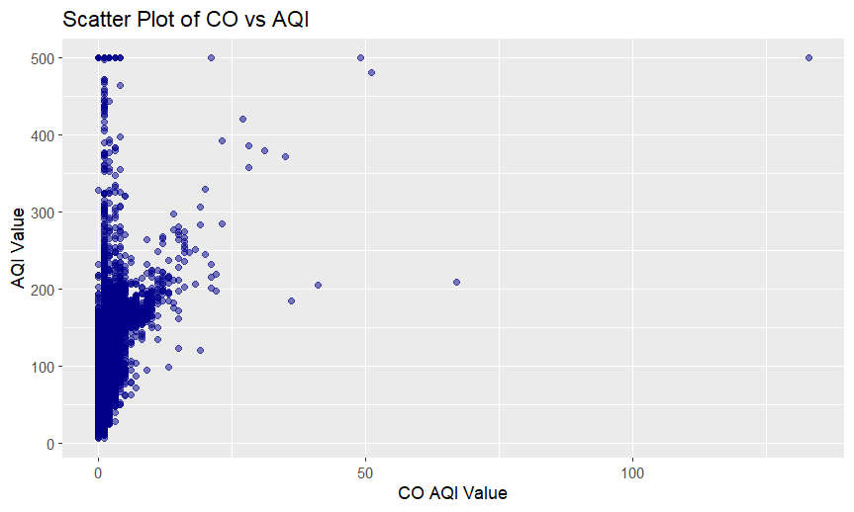
Bivariate Analysis
ggplot(df, aes(x = CO, y = AQI.Value)) + geom_point(color = "darkblue", alpha = 0.5) + labs(title = "Scatter Plot of CO vs AQI", x = "CO AQI Value", y = "AQI Value")

Slide 10
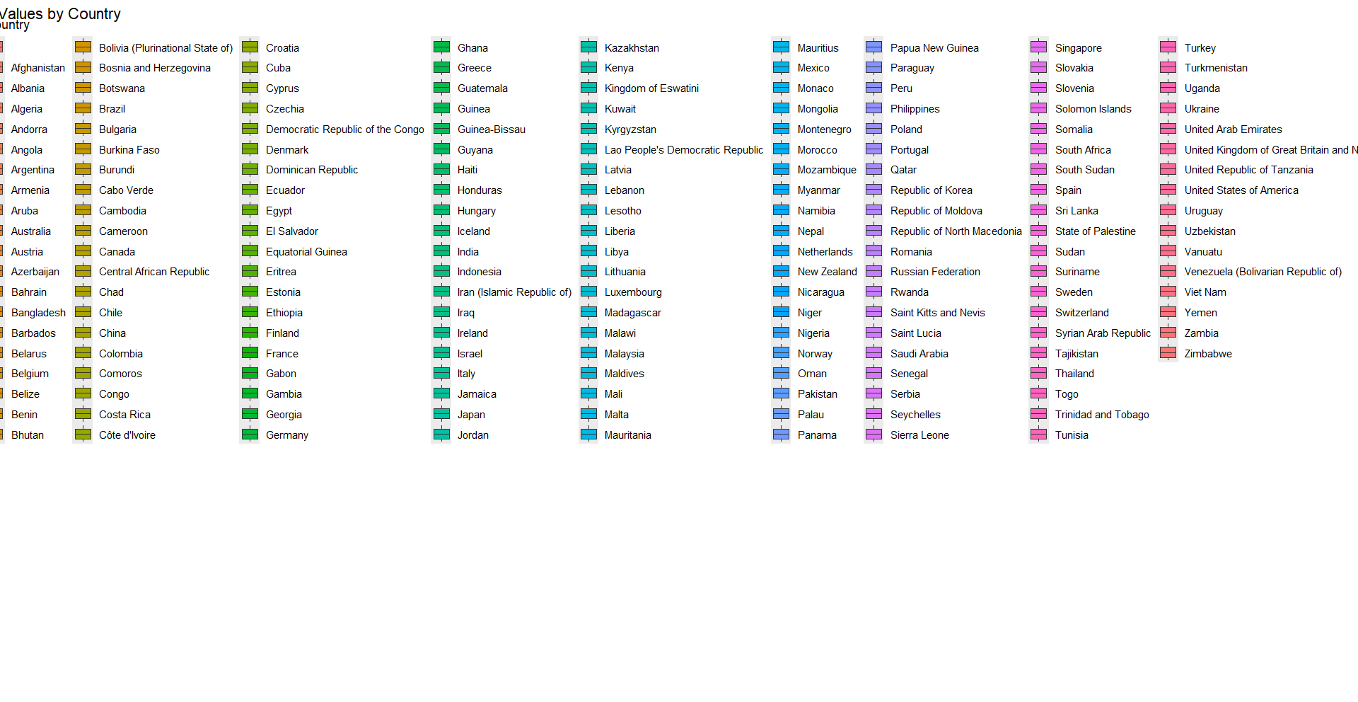
ggplot(df, aes(x = Country, y = AQI.Value, fill = Country)) + geom_boxplot() + labs(title = "AQI Values by Country", x = "Country", y = "AQI Value") + theme(axis.text.x = element_text(angle = 90, hjust = 1))

Slide 11
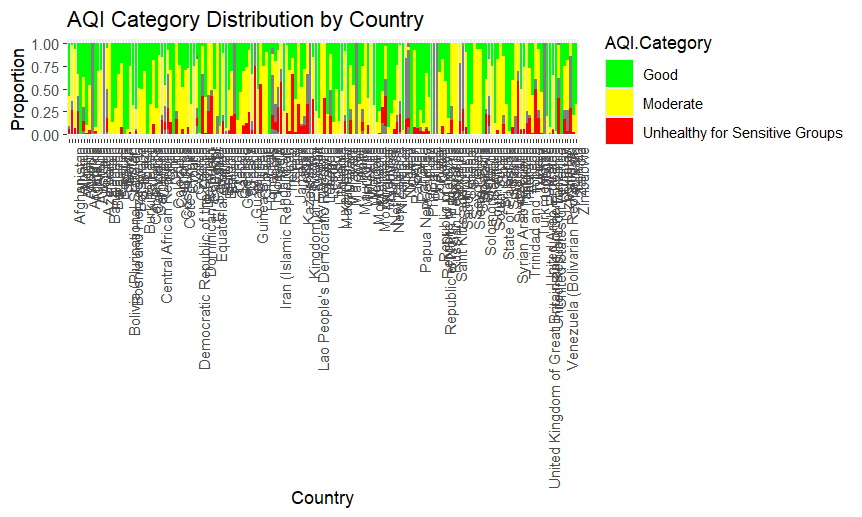
Multivariate Analysis
ggplot(df, aes(x = Country, fill = AQI.Category)) + geom_bar(position = "fill") + labs(title = "AQI Category Distribution by Country", x = "Country", y = "Proportion") + scale_fill_manual(values = c("Good" = "green", "Moderate" = "yellow", "Unhealthy for Sensitive Groups" = "red")) + theme(axis.text.x = element_text(angle = 90, hjust = 1))

Slide 12
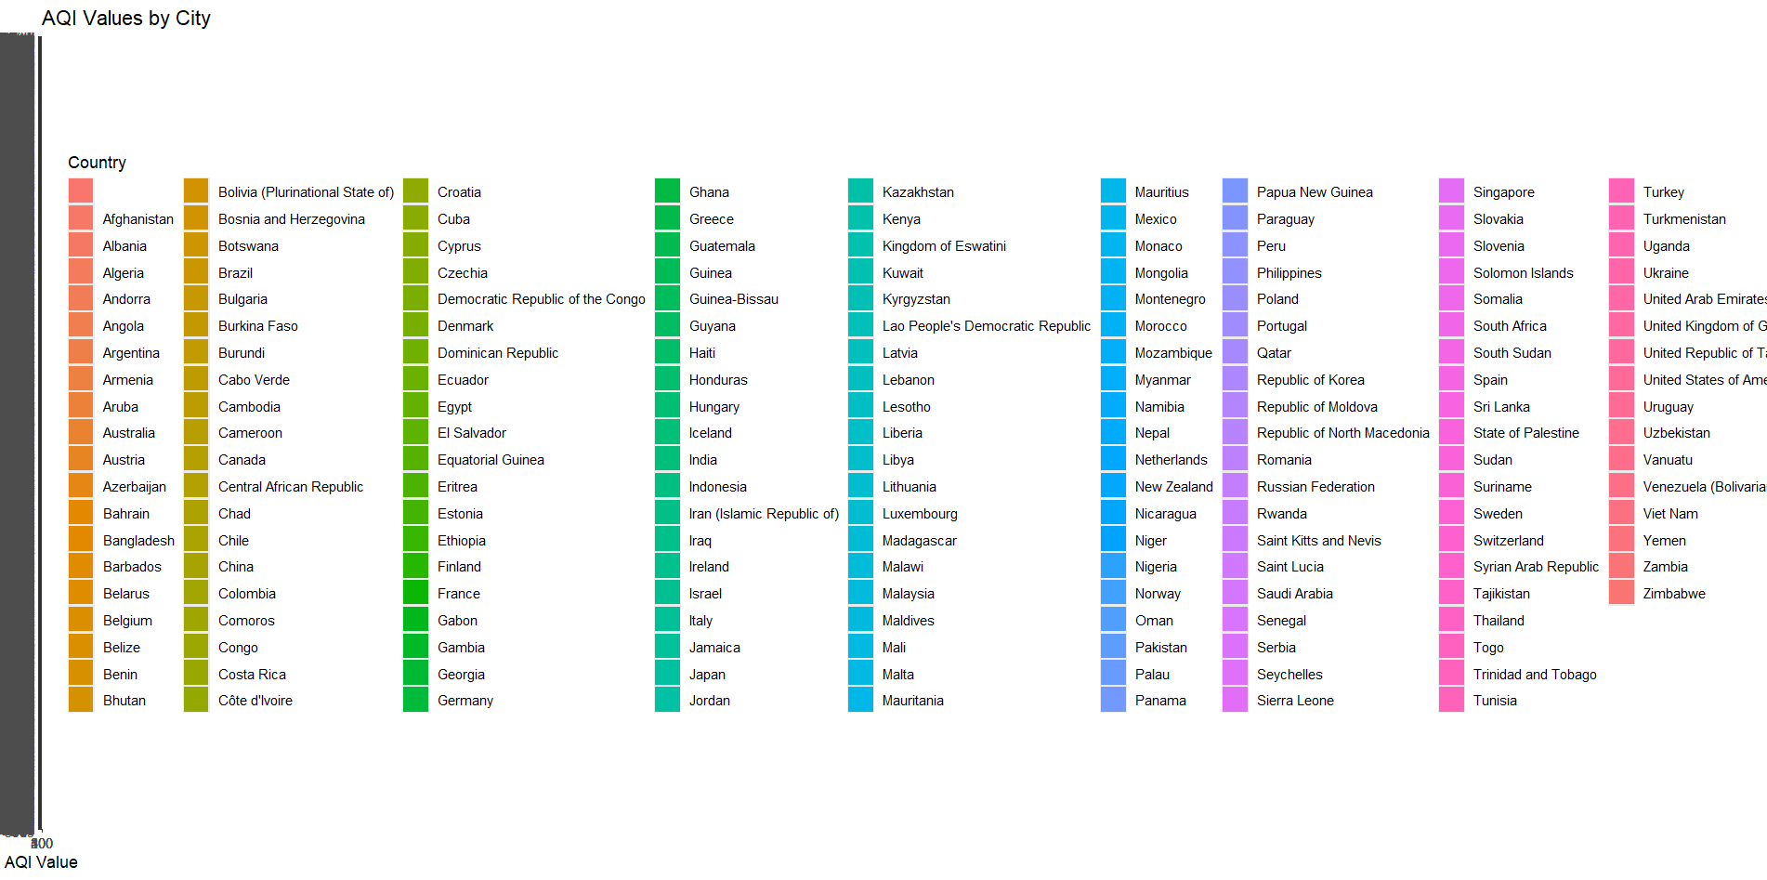
ggplot(df, aes(x = reorder(City, AQI.Value), y = AQI.Value, fill = Country)) + geom_bar(stat = "identity") + labs(title = "AQI Values by City", x = "City", y = "AQI Value") + coord_flip()

Slide 13
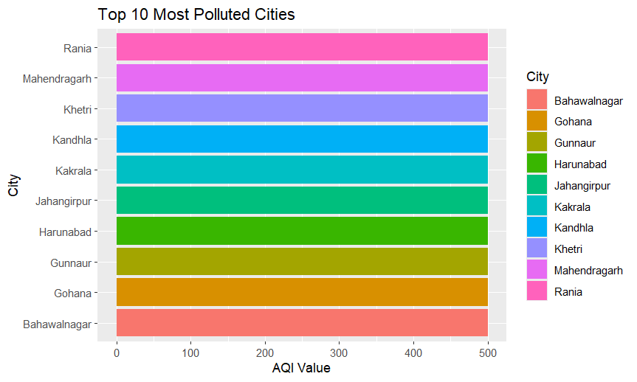
top_10_cities <- df %>% arrange(desc(AQI.Value)) %>% head(10)ggplot(top_10_cities, aes(x = reorder(City, AQI.Value), y = AQI.Value, fill = City)) + geom_bar(stat = "identity") + labs(title = "Top 10 Most Polluted Cities", x = "City", y = "AQI Value") + coord_flip()

Slide 14
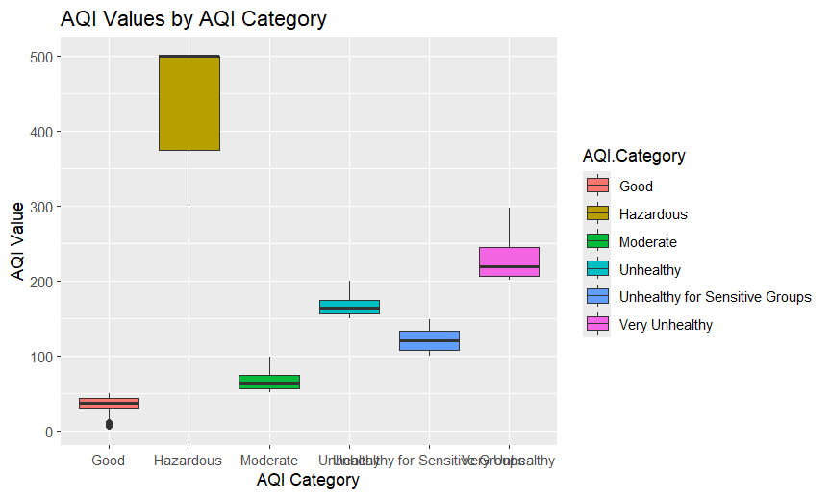
ggplot(df, aes(x = AQI.Category, y = AQI.Value, fill = AQI.Category)) + geom_boxplot() + labs(title = "AQI Values by AQI Category", x = "AQI Category", y = "AQI Value")

Slide 15
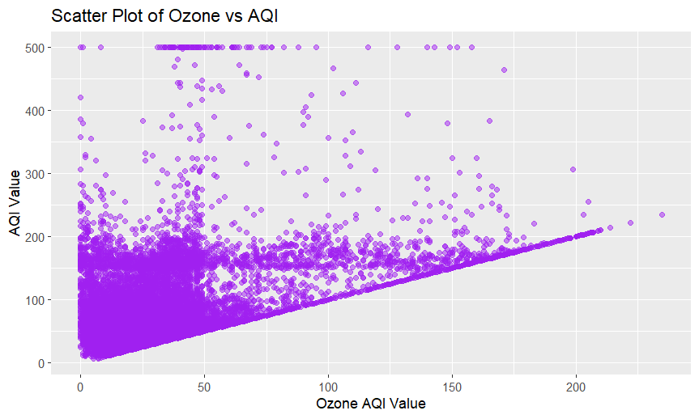
ggplot(df, aes(x = Ozone, y = AQI.Value)) + geom_point(color = "purple", alpha = 0.5) + labs(title = "Scatter Plot of Ozone vs AQI", x = "Ozone AQI Value", y = "AQI Value")

Slide 16
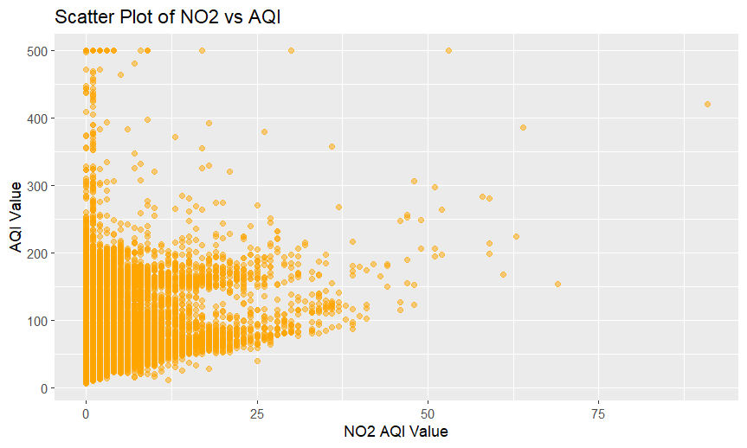
ggplot(df, aes(x = NO2, y = AQI.Value)) + geom_point(color = "orange", alpha = 0.5) + labs(title = "Scatter Plot of NO2 vs AQI", x = "NO2 AQI Value", y = "AQI Value")

Slide 17
Performance Insights
Key Patterns and Trends
Correlations Between Pollutants and AQI
Pollution Hotspots
AQI Values Distribution: Most cities show a clustering of AQI values, with significant frequencies in certain ranges.
AQI Categories: The majority of cities fall into "Good" or "Moderate" categories, indicating general air quality conditions.
CO, Ozone, NO2, PM2.5: Scatter plots reveal how each pollutant relates to overall AQI. Strong correlations indicate which pollutants are major contributors to poor air quality.
Top Polluted Cities: Identifies cities with the highest AQI values, highlighting areas needing urgent air quality improvements.
Country Comparisons: Boxplots show which countries have higher or lower AQI values, indicating global air quality trends.

Slide 18
Key Recommendations
Improvement Areas
Policy Recommendations
Further Research
Pollution Control: Implement measures in the most polluted cities to reduce CO, Ozone, NO2, and PM2.5 levels.
Target Major Pollutants: Focus on reducing the pollutants most strongly correlated with high AQI values.
Pollution Sources: Investigate specific pollution sources in high-AQI areas.
Long-Term Trends: Analyze long-term data to assess the effectiveness of policies and track changes in air quality.
Stricter Regulations: Enforce stronger environmental regulations to control emissions.
Public Awareness: Educate the public on air quality and promote practices that reduce pollution.

Slide 19

THANKS
Vishnu G Nath

